Slide 1
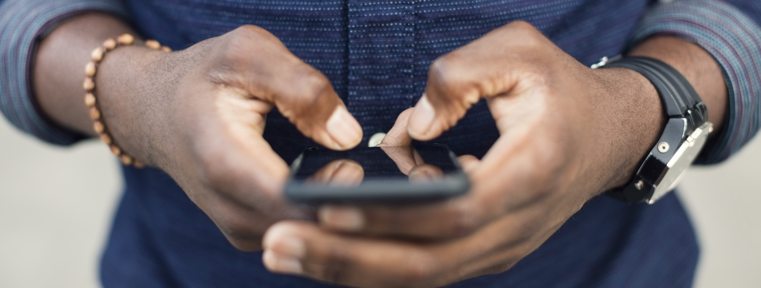
The BÜHLMANN IBDoc® Calprotectin Home Test
Getting started

Slide 2
How to sign up for an account?
If your clinic wants you to use the IBDoc calprotectin home test, then they will sign you up for an account – speak to your clinical team.
Once an account has been created you will receive an email from support@ibdoc.net with a link to set a password. Check your spam/junk folder if you don’t receive the email.
This link is time sensitive, if it has expired before you have set the password then go onto the App, enter your email and then use the forgotten password button and a new email will be sent.

Slide 3
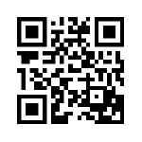
How do I access the App?
Smartphone
You need to have an approved Smartphone to use the IBDoc. There are about 80 phones approved for use with the App, both Android and iPhones, but more are being added all the time – for a complete list please visit : https://www.calprotectin.co.uk/calprotectin-products/calprotectin-products-patient-self-testing/#1520588526160-5c107c8b-9bcc
You don’t need to own the phone, only have access to it, because everything is password protected and therefore private. So maybe a family member has an approved phone.
The IBDoc App is downloaded for free either from the Apple App store or the Google play store (CalApp) or you can use the QR code on the IBDoc kit:

Slide 4
Logging in…
You will need to allow the App the have access to the camera – this is what is used to read the test.
Once the App is installed you can sign in using your email address and password.
The email in this instance is case sensitive, and so must be in the same format as was set up by the clinic. If you get a message saying the email isn’t recognised then check with the clinic if any capitals were used.
Once you have logged in the first thing the App will want to do is a camera check using the card in the kit.
Once this is completed you are ready to do a test. Check out the step-by-step instructions for this: https://www.youtube.com/watch?v=_88L-gt52hI

