Slide 1
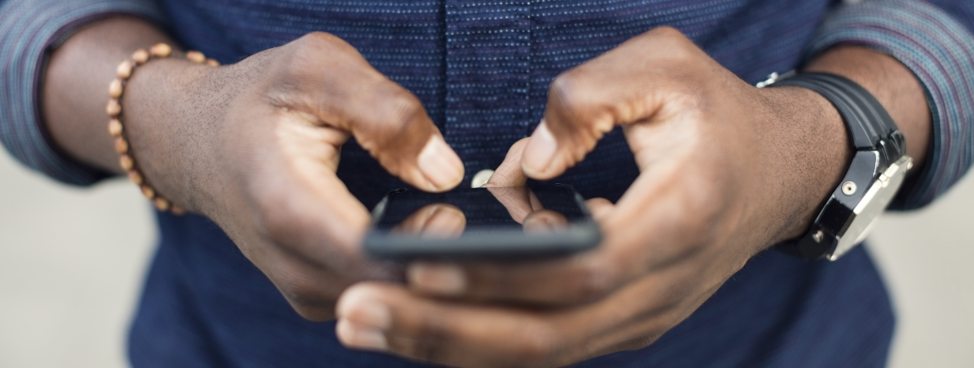
The BÜHLMANN IBDoc® Calprotectin Home Test
Getting started

Slide 2
How to sign up for an account?
If your clinic wants you to use the IBDoc calprotectin home test, then they will sign you up for an account – speak to your clinical team.
Once an account has been created you will receive an email from support@ibdoc.net with a link to set a password. Check your spam/junk folder if you don’t receive the email.
This link is time sensitive, if it has expired before you have set the password then go onto the App, enter your email and then use the forgotten password button and a new email will be sent.

Slide 3
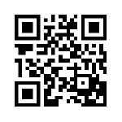
How do I access the App?
Smartphone
You need to have an approved Smartphone to use the IBDoc. There are more than a 100 phones approved for use with the App, both Android and iPhones, but as new phones are released, they are added to the approved list, once validated – for a complete list please click here.
You don’t need to own the phone, only have access to it, because everything is password protected and therefore private. So maybe a family member has an approved phone.
The IBDoc App is downloaded for free either from the Apple App store or the Google play store or you can use the QR code on the IBDoc kit:

Slide 4
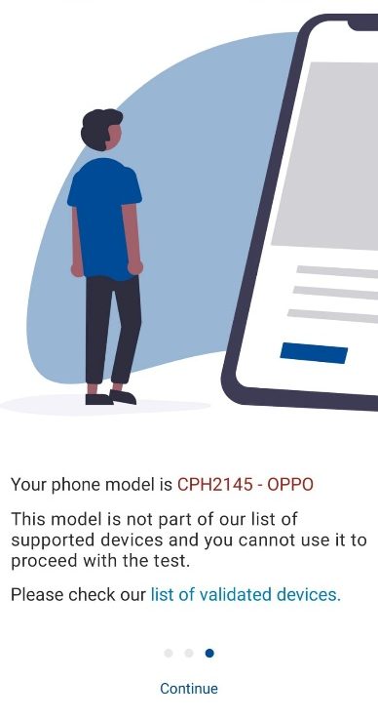
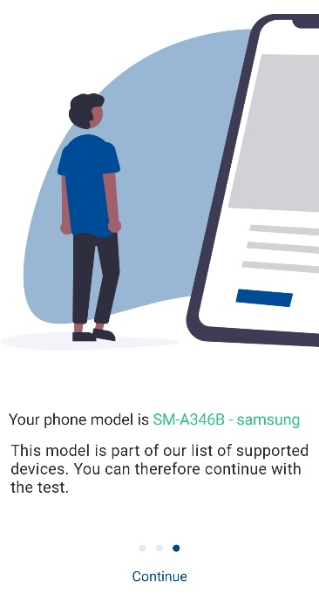
Introductory Screens
Once the App has been downloaded your phone will be checked for the compatibility as shown.

Slide 5
Logging in…
Once the App has confirmed your phone is compatible, you can sign in using your username and password.
Once this is completed you are ready to do a test. Check out the step-by-step instructions for this.

